Slide 1

Requirements

Slide 2
Understand and specifying requirements
  A problem of scale
    For small scale: understand and specifying requirements is easy
    For large scale: very hard; probably the hardest, most problematic and error prone
  The requirements task:
    Input: User needs in minds of people (hopefully)
    Output: precise statement of what the future system will do
Requirements

Slide 3
Challenges
Identifying and specifying requirements
  Necessarily involves people interaction
  Cannot be automated
Requirements

Slide 4
Background..
What is a Requirement?
  A condition or capability that must be possessed by a system (IEEE)
What is the work product of the Req. phase ?
  A software requirements specification (SRS) document
What is an SRS ?
  A complete specification of what the proposed system should do!
Requirements

Slide 5
Background..
Requirements understanding is hard
  Visualizing a future system is difficult
  Capability of the future system not clear, hence needs not clear
  Requirements change with time
  …
Essential to do a proper analysis and specification of requirements
Requirements

Slide 6
Purpose of SRS document?
SRS establishes basis of agreement between the user and the supplier.
  Users needs have to be satisfied, but user may not understand software
  Developers will develop the system, but may not know about problem domain
SRS is
  the medium to bridge the communications gap, and
  specifies user needs in a manner both can understand
Requirements

Slide 7
Need for SRS…
Helps user understand his needs.
  users do not always know their needs
  must analyze and understand the potential
  The requirement process helps clarify needs
SRS provides a reference for validation of the final product
  Clear understanding about what is expected.
  Validation - “ SW satisfies the SRS “
Requirements

Slide 8
Need for SRS…
High quality SRS essential for high Quality SW
  Requirement errors get manifested in final sw
  To satisfy the quality objective, must begin with high quality SRS
  Requirements defects cause later problems
    25% of all defects in one study; 54% of all defects found after user testing
    defects often found in previously approved SRS.
Requirements

Slide 9
Need for SRS…
Good SRS reduces the development cost
  SRS errors are expensive to fix later
  Req. changes can cost a lot (up to 40%)
  Good SRS can minimize changes and errors
  Substantial savings; extra effort spent during req. saves multiple times that effort
An Example
  Cost of fixing errors in req. , design , coding , acceptance testing and operation are 2 , 5 , 15 , 50 , 150 person-months
Requirements

Slide 10
Requirements Process
Basic activities:
  Problem or requirement analysis
  Requirement specification
  Validation
Analysis involves elicitation and is the hardest
Requirements

Slide 11
Requirement process..
needs
Process is not linear, it is iterative and parallel
Overlap between phases - some parts may be analyzed and specified
Specification itself may help analysis
Validation can show gaps that can lead to further analysis and spec
Analysis
Specification
Validation
Requirements

Slide 12
Requirements Process…
Divide and conquer is the basic strategy
  Decompose into small parts, understand each part and relation between parts
Large volumes of information is generated
  Organizing them is a key
Techniques like data flow diagrams, object diagrams etc. used in the analysis
Requirements

Slide 13
Problem Analysis
Analysis
Specification
Aim: to gain an understanding of the needs, requirements, and constraints on the software
Analysis involves
  Interviewing client and users
  Reading manuals
  Studying current systems
  Helping client/users understand new possibilities
  Like becoming a consultant
Must understand the working of the organization , client, and users
Validation
Requirements

Slide 14
Problem Analysis…
Some issues
  Obtaining the necessary information
  Brainstorming: interacting with clients to establish desired properties
  Information organization, as large amount of info. gets collected
  Ensuring completeness
  Ensuring consistency
  Avoiding internal design
Requirements

Slide 15
Problem Analysis…
Interpersonal issues are important
Communication skills are very important
Basic principle: problem partition
Partition w.r.t what?
  Object - OO analysis
  Function - structural analysis
  Events in the system – event partitioning
Projection - get different views
Will discuss few different analysis techniques
Requirements

Slide 16
Informal Approach to Analysis
No defined methodology; info obtained through analysis, observation, interaction, discussions,…
No formal model of the system built
Obtained info organized in the SRS; SRS reviewed with clients
Relies on analyst experience and feedback from clients in reviews
Useful in many contexts
Requirements

Slide 17
Data Flow Modeling
Widely used; focuses on functions performed in the system
Views a system as a network of data transforms through which the data flows
Uses data flow diagrams (DFDs) and functional decomposition in modeling
The Structured System Analysis and Design (SSAD) methodology uses DFD to organize information, and guide analysis
Requirements

Slide 18
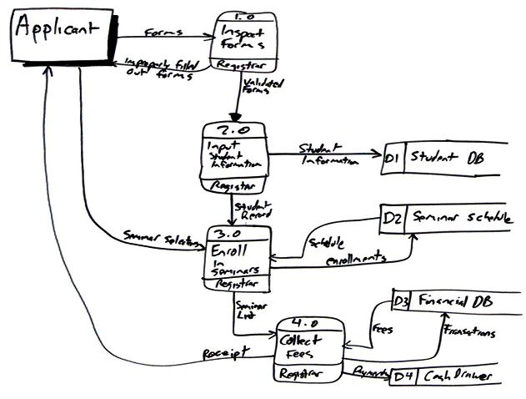
Example DFD: Enrolling in a University
Requirements
In Gane and Sarson notation

Slide 19
Data flow diagrams
There are only four symbols:
Squares representing external
entities, which are sources or
destinations of data.
Rounded rectangles representing processes, which take data as input, do something to it, and output it.
Arrows representing the data flows, which can either be electronic data or physical items.
Open-ended rectangles representing data stores, including electronic stores such as databases or XML files and physical stores such as or filing cabinets or stacks of paper.
Requirements

Slide 20
Data flow diagrams
A DFD shows flow of data through the system
  Views system as transforming inputs to outputs
  Transformation done through transforms
  DFD captures how transformation occurs from input to output as data moves through the transforms
  Not limited to software
Requirements

Slide 21
Data flow diagrams…
Other common DFD notation:
  A rectangle represents a source or sink and is originator/consumer of data (often outside the system)
  Transforms represented by named circles/bubbles
  Bubbles connected by arrows on which named data travels
  Data stored underlined
Moral: choose one and stick with it – can be helpful to provide a legend to make sure readers are aware of the conventions in use
Requirements

Slide 22
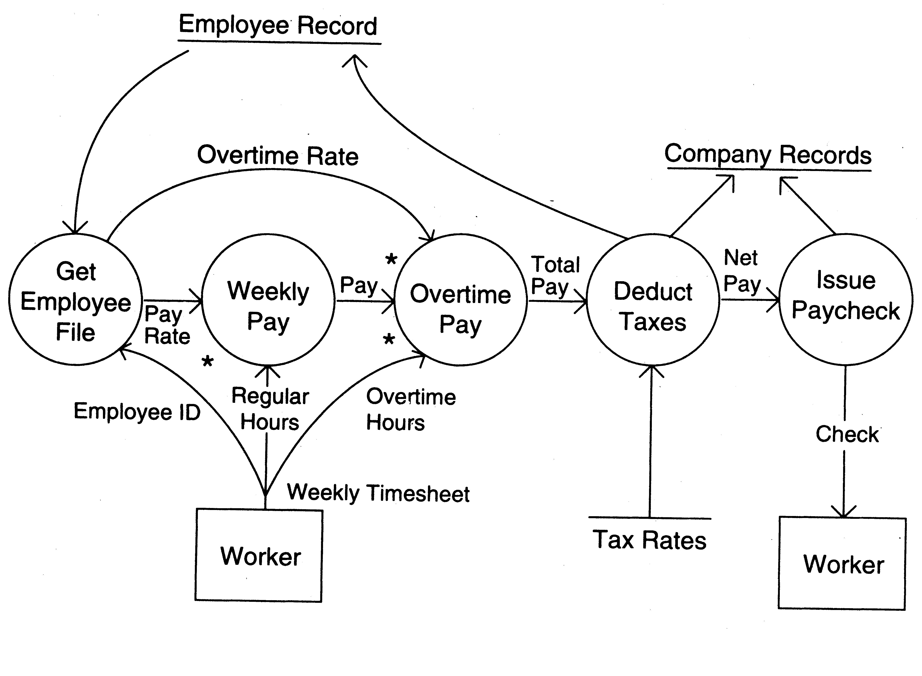
DFD Example
Requirements

Slide 23
DFD Conventions
External files shown as labeled straight lines
Need for multiple data flows by a process represented by * (means and)
OR relationship represented by +
All processes and arrows should be named
Processes should represent transforms, arrows should represent some data
Requirements

Slide 24
Data flow diagrams…
Focus on what transforms happen, how they are done is not important
Usually major inputs/outputs shown, minor are ignored in this modeling
No loops , conditional thinking , …
DFD is NOT a control chart, no algorithmic design/thinking
Requirements

Slide 25
Other Approaches to RA
Prototyping
  Evolutionary
  Throw-away
Object Oriented
  Classes, attributes, methods
  Association between classes
  Class hierarchies
Requirements

Slide 26
Requirements Specification
Analysis
Specification
Final output of requirements task is the SRS
Why are DFDs, OO models, etc not SRS ?
  SRS focuses on external behavior, while modeling focuses on problem structure
  UI etc. not modeled, but have to be in SRS
  Error handling, constraints etc. also needed in SRS
Transition from analysis to specification is not straight forward
Knowledge about the system acquired in analysis used in specification
Validation
Requirements

Slide 27
Characteristics of an SRS
Correct
Complete
Unambiguous
Consistent
Verifiable
Traceable
Modifiable
Ranked for importance and/or stability
Requirements

Slide 28
Characteristics…
Correctness
  Each requirement accurately represents some desired feature in the final system
Completeness
  All desired features/characteristics specified
  Hardest to satisfy
  Completeness and correctness strongly related
Unambiguous
  Each req has exactly one meaning
  Without this errors will creep in
  Important as natural languages often used
Requirements

Slide 29
Characteristics…
Verifiability
  There must exist a cost effective way of checking if sw satisfies requirements
Consistent
  two requirements don’t contradict each other
Traceable
  The origin of the req, and how the req relates to software elements can be determined
Ranked for importance/stability
  Needed for prioritizing in construction
  To reduce risks due to changing requirements
Requirements

Slide 30
Components of an SRS
What should an SRS contain ?
  Clarifying this will help ensure completeness
An SRS must specify requirements on
  Functionality
  Performance
  Design constraints
  External interfaces
Requirements

Slide 31
Functional Requirements
Heart of the SRS document; this forms the bulk of the specs
Specifies all the functionality that the system should support
Outputs for the given inputs and the relationship between them
All operations the system is to do
Must specify behavior for invalid inputs too
Requirements

Slide 32
Performance Requirements
All the performance constraints on the software system
Generally on response time , throughput etc => dynamic
Capacity requirements => static
Must be in measurable terms (verifiability)
  Eg resp time should be xx 90% of the time
Requirements

Slide 33
Design Constraints
Factors in the client environment that restrict the choices
Some such restrictions
  Standard compliance and compatibility with other systems
  Hardware Limitations
  Reliability, fault tolerance, backup req.
  Security
Requirements

Slide 34
External Interface
All interactions of the software with people, hardware, and sw
User interface most important
General requirements of “friendliness” should be avoided
These should also be verifiable
Requirements

Slide 35
Specification Language
Language should support desired charateristics of the SRS
Formal languages are precise and unambiguous but hard
Natural languages mostly used, with some structure for the document
Formal languages used for special features or in highly critical systems
Requirements

Slide 36
Structure of an SRS
Introduction
  Purpose , the basic objective of the system
  Scope of what the system is to do , not to do
  Overview
Overall description
  Product perspective
  Product functions
  User characteristics
  Assumptions
  Constraints
Requirements

Slide 37
Structure of an SRS…
Specific requirements
  External interfaces
  Functional requirements
  Performance requirements
  Design constraints
Acceptable criteria
  desirable to specify this up front.
This standardization of the SRS was done by IEEE.
Requirements

Slide 38
Requirements Validation
Analysis
Specification
Lot of room for misunderstanding
Errors possible
Expensive to fix req defects later
Must try to remove most errors in SRS
Most common errors
  Omission - 30%
  Inconsistency - 10-30%
  Incorrect fact - 10-30%
  Ambiguity - 5 -20%
Validation
Requirements

Slide 39
Requirements Review
SRS reviewed by a group of people
Group: author, client, user, dev team rep.
Must include client and a user
Process – standard inspection process
Effectiveness - can catch 40-80% of req. errors
Requirements

Slide 40
Summary
Having a good quality SRS is essential for Q&P
The req. phase has 3 major sub phases
  analysis , specification and validation
Analysis
  for problem understanding and modeling
  Methods used: SSAD, OOA , Prototyping
Key properties of an SRS: correctness, completeness, consistency, traceablity, unambiguousness
Requirements

Slide 41
Summary..
Specification
  must contain functionality, performance , interfaces and design constraints
  Mostly natural languages used
Validation - through reviews
Requirements

